Slide 1

Amazon Sentiment Analysis CP2

Slide 2


Slide 3

Tool Used:-

Slide 4
AIM:-
Improvement of Decision-Making:
Contribute to improved decision-making processes by providing businesses with a deeper understanding of customer satisfaction, preferences, and areas of improvement.
What is Sentiment:-
Sentiment Analysis, also known as opinion mining, is the process of using natural language processing and machine learning techniques to determine the emotional tone behind a piece of text.

Slide 5
Application :-
Explore the diverse applications of sentiment analysis, including:
Customer feedback analysis
Brand monitoring
Social media monitoring
Market research
Reputation management
Working Principle:
Sentiment analysis uses natural language processing algorithms to analyze the structure and context of text data.
Machine learning models are trained to classify text as positive, negative, or neutral based on the emotional tone.

Slide 6
Why is it Important ?
In today's digital age, vast amounts of textual data are generated daily through social media, reviews, and customer feedback.
Sentiment analysis helps businesses and organizations extract valuable insights from this data by understanding the sentiments expressed.
In an era of vast data generation, sentiment analysis provides insights into public opinion, customer feedback, and brand perception.

Slide 7
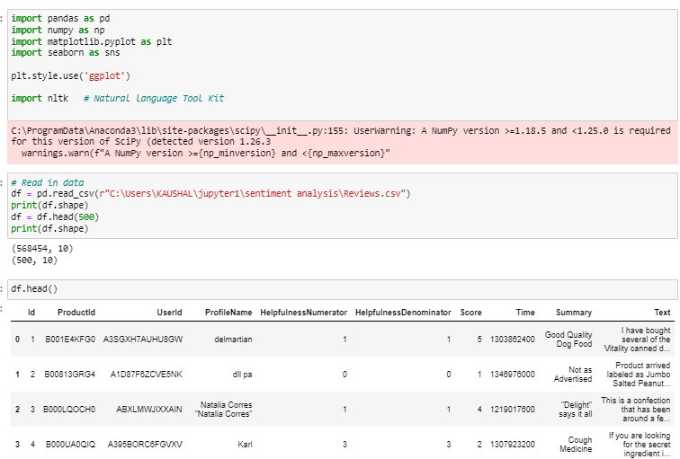
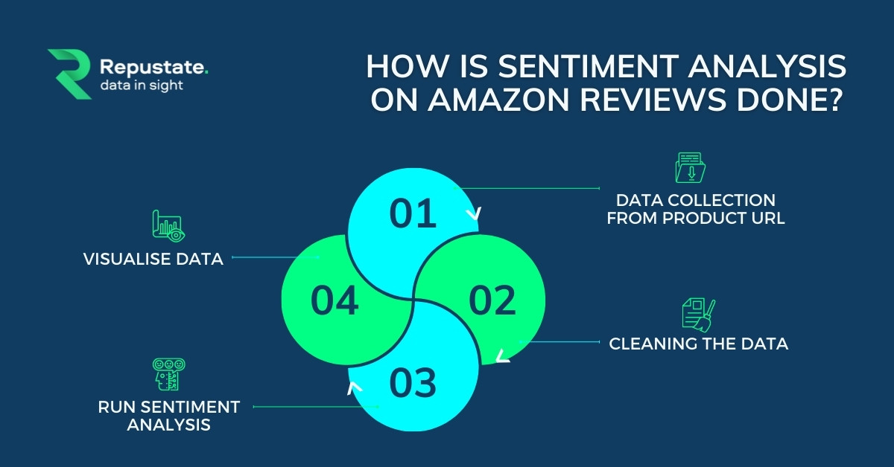
5. Preprocessing Steps:
Text Cleaning: Removing irrelevant characters, stopwords, and handling punctuation.
Tokenization: Breaking down sentences into tokens for input to deep learning models.
Embedding Representation: Converting words into numerical vectors using techniques like Word Embeddings (e.g., Word2Vec, GloVe).

Slide 8
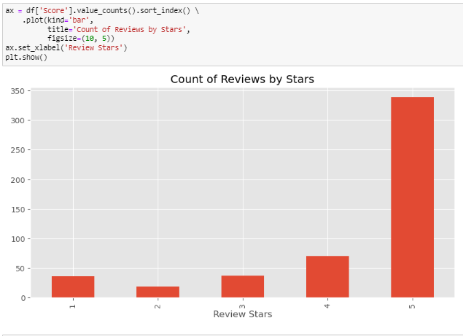
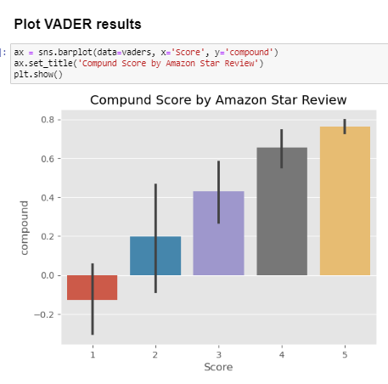
Exploratory Data Analysis (EDA)

Slide 9
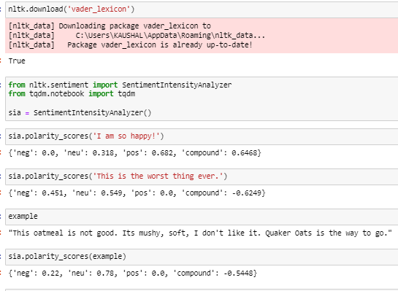
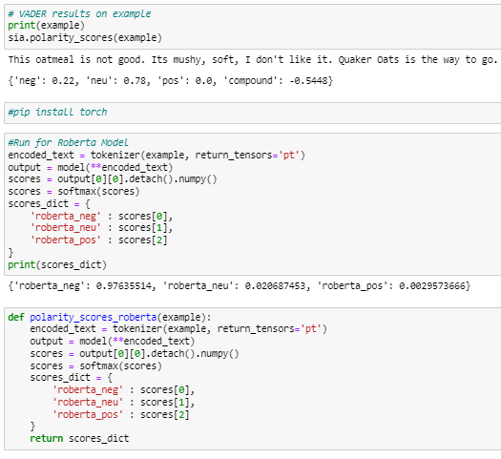
VADAR Sentiment Scoring :- - This uses a "bag of words" approach: 1. Stop words are removed 2. each word is scored and combined to a total score.

Slide 10
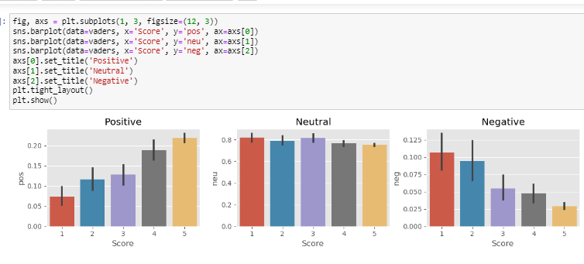
Compare the Score basis on Positive , Neutral & Negative:-

Slide 11
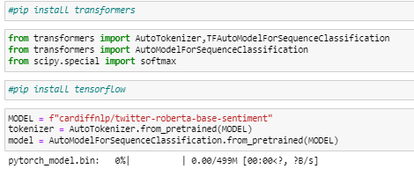
Roberta Pretrain Model

Slide 12
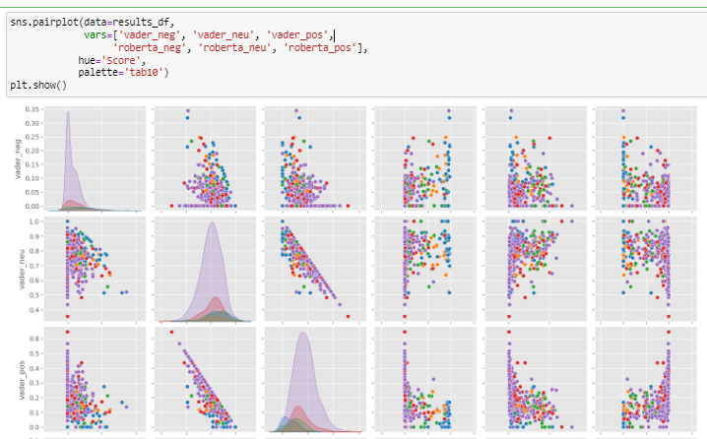
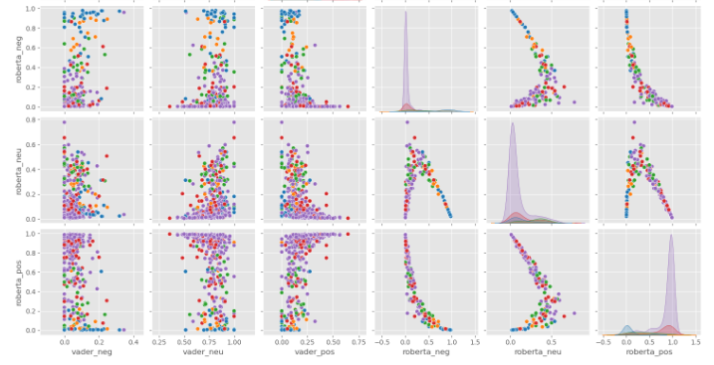

Slide 13
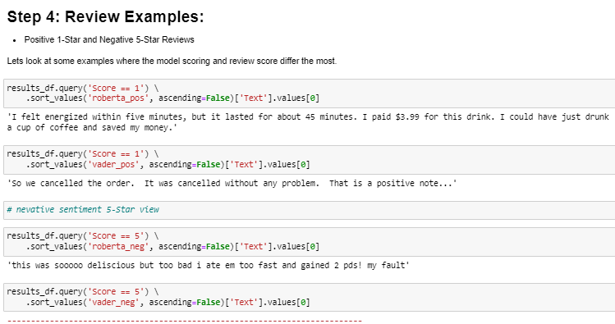
Review Basis on Number & Star:-

Slide 14
Assumptions:-
Assumptions play a crucial role in any analytical or modeling process, including sentiment analysis. It's important to be aware of and explicitly state the assumptions made during the analysis to ensure transparency and reliability.
Each piece of text is homogeneous in its sentiment, meaning that the sentiment expressed is consistent throughout the entire text.
The labeled training data is consistent and accurate. This is crucial for supervised learning models.
Sentiment analysis assumes that the model understands the language being analyzed proficiently.
Sentiments expressed in the past will continue to hold in the future.

Slide 15
Conclusion:-
The Amazon review dataset is a collection of textual reviews provided by users on the Amazon platform.
It includes a large volume of user-generated content, encompassing diverse product categories and sentiments.
Each review is associated with a rating (e.g., star rating) indicating the user's sentiment.

